Slide 1
Capestone project

Slide 2
IntroDuction:
If a Businessman has a successful restaurant at a place in a city, He would tend to open his next restaurant at place similar to the successful restaurant’s place in another city.
The goal is to find which neighborhood of Central Bangalore is like Madhapur , Hyderbad.

Slide 3
Methodology
Collect data of nearby places of Madhapur
Collect data of nearby places of each neighborhood of Central Bangalore
Then Perform K-Means Clustering and find out which neighbothood is clustered with Madhapur.

Slide 4
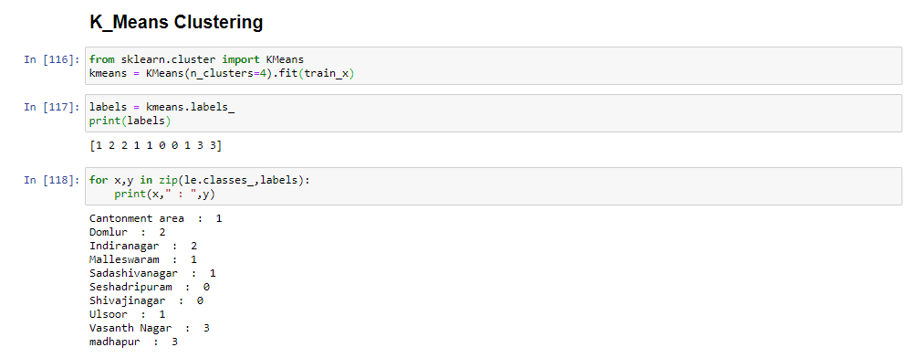
Result
Vasanth Nagar,Central Banglore is more like Madhapur,Hyderabd

